Slide 1
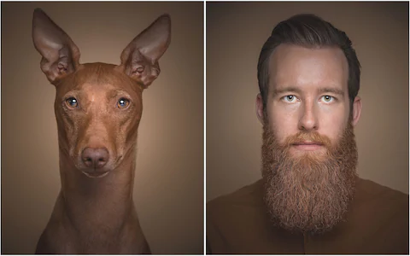

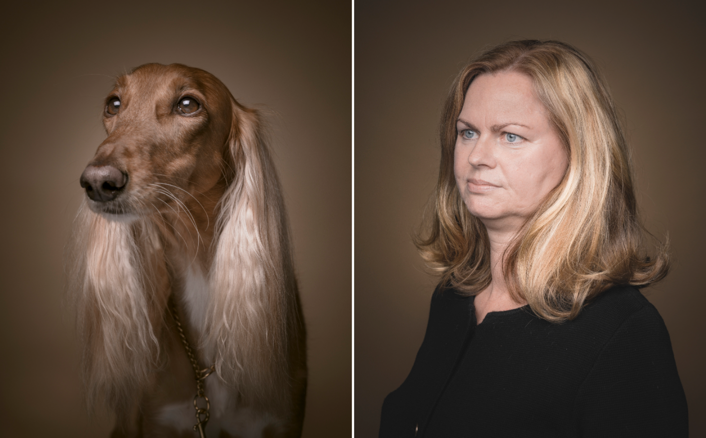
My Dog Ate my Match Profile
Mohit Bhole & Andria McIntyre
“Like Owner, Like Dog” (Soerboe, 2018)

Slide 2
Problem
Determining personality is important for making connections, but self-administered personality analysis and tests are unreliable
Pros: Convenient
Cons: Conscious and unconscious bias
(Caldwell-Andrews et al., 2000)
Peer-administered personality tests are more reliable
Pros: Less bias and social desirability influence
(Cheek, Jonathan M)
Cons: Not convenient or possible in many applications
Combination system required
Peer administered reliability and self-administered convenience

Slide 3
Solution
Use pets as peers
Pet and owner personalities are directly correlated
(Turcsán, Borbála, et al., 2012)
Research applies to cats and dogs
Owners report their pet’s personality to learn their own personality
Limited bias or deception (reliable)
Convenient
Bonus!—Pets will likely be compatible with their owner’s human matches, leading to better relationships for both pets and humans

Slide 4
Product
Web application for creating romantic and platonic connections between pet owners
Steps:
Users describe pet personality through adjectives and essay
Processed adjectives and essay using NRC Word-Emotion Association Lexicon to assign emotional meaning to words in pet description
Used SVM, Decision Tree, Naïve Bayes, Logistic Regression, and Random Forest in combination to predict Big-5 personality trait profile
(Majumder, Navonil, et al., 2017)
Big 5 Traits: Openness, Agreeableness, Neuroticism, Extraversion, Conscientiosness
Found Euclidian distance between features of pet profiles to determine best match between pets—consequentially matching humans too

Slide 5
Demo Time!

Slide 6
Conclusion
Analyzing pet personality to determine human compatibility appeals to those seeking real connections between both animals and humans
This will help pet-owning singles find what they’re looking for: accurate dating profiles and compatible pets!

Slide 7
Works Cited
Caldwell-Andrews, Alison, et al. “Effects of Response Sets on NEO-PI-R Scores and Their Relations to External Criteria.” Journal of Personality Assessment, vol. 74, no. 3, 2000, pp. 472–88. Crossref, doi:10.1207/s15327752jpa7403_10.
Cheek, Jonathan M. “Aggregation, Moderator Variables, and the Validity of Personality Tests: A Peer-Rating Study.” Journal of Personality and Social Psychology, vol. 43, no. 6, 1982, pp. 1254–69. Crossref, doi:10.1037/0022-3514.43.6.1254.
Majumder, Navonil, et al. “Deep Learning-Based Document Modeling for Personality Detection from Text.” IEEE Intelligent Systems, vol. 32, no. 2, 2017, pp. 74–79. Crossref, doi:10.1109/mis.2017.23.
Turcsán, Borbála, et al. “Birds of a Feather Flock Together? Perceived Personality Matching in Owner–Dog Dyads.” Applied Animal Behaviour Science, vol. 140, no. 3–4, 2012, pp. 154–60. Crossref, doi:10.1016/j.applanim.2012.06.004.

